Slide 1


Computer Vision
(Medical Imaging - Breast Tumor Classification)

Slide 2
Table of contents
Abstract
Introduction
Problem Statement
Literature Reviews
Dataset Overview
Data Preprocessing steps
Augmentation Technique Applied
Image Preprocessing Techniques
Feature Extraction With HOG
Machine Learning Approach
Why Random Forest Outperformed SVM
CNN Architecture
MobileNetV2 Architecture
Final Result
Software Block Diagram
Sample Image of Stage classification
Key Findings
Challenges Faced
Future Scope
Deployment Approach
Prediction Flow

Slide 3
Abstract
This project aims to develop a machine learning and deep learning-based model to classify breast tumor images into three stages: Non Cancer, Early, Middle.
Early and accurate detection of tumor stages is critical for improving treatment outcomes.
By leveraging advanced algorithms, we aim to provide a reliable tool for clinicians.

Slide 4
Introduction:
Goal: Predict the stage of breast tumors (Non_cancer , Early Phase, Middle Phase).
Methodology: Utilize image data to train models for classification using ML and DL.
Algorithms Chosen: SVM , Random Forest , CNN , Pre-trained deep learning models (e.g., MobileNetV2), Transfer Learning for improved performance.

Slide 5
Problem Statement :
Problem: Develop a robust system for early-stage breast tumor detection and classification.
Objective: Accurately identify tumor regions in historical medical images using advanced techniques :
Image processing methods like Enhancement techniques, Image Segmentation Otsu’s thresholding, Feature extraction (HOG), and Canny Edge Detection.
Machine learning models, including Random Forest, SVM and Deep Learning concepts (CNN) and leveraging the pre-trained models (MobileNetV2).
Challenge: Tumor images vary in size, texture, and clarity. A robust model is needed to classify correctly.

Slide 6
Literature Reviews
Breast Cancer Detection and Classification Using Hybrid Feature Selection and DenseXNet Approach (2023)
Brain Tumor Segmentation Based on an Improved U-Net(2022)
Deep Learning Approaches for Brain Tumor Detection(2021)
Comprehensive Review on MRI-Based Tumor Segmentation (2021)
An Early Detection and Segmentation of Brain Tumor Using Neural Networks(2022)
Machine Learning and Deep Learning for Tumor Detection(2020)
Deep Learning Techniques for Tumor Segmentation(2022)

Slide 7
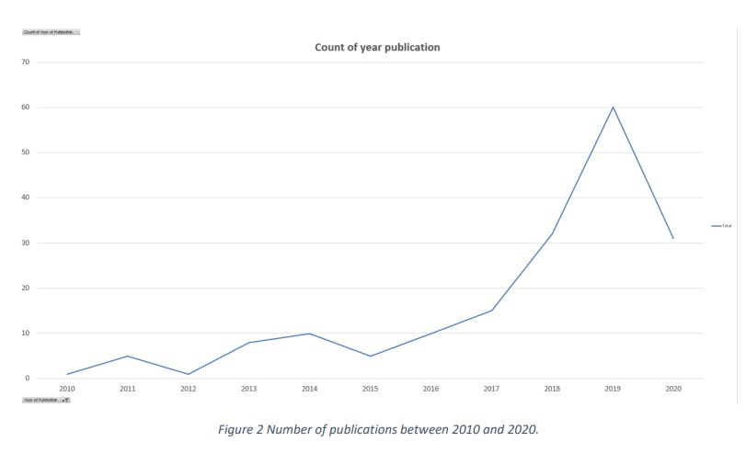
Overview of the Publications
The peak in breast cancer research publications around 2019-2020 was driven by advancements in AI, machine learning, and medical imaging, which enhanced detection and classification methods. Global awareness campaigns, increased funding, and interdisciplinary collaboration also contributed to this surge. These years saw an emphasis on early detection and precision medicine to combat breast cancer.
COVID-19 Pandemic Impact: Research efforts were redirected toward pandemic-related studies, and lab closures slowed other research fields.
Funding Shifts: Resources were reallocated to urgent health crises.

Slide 8
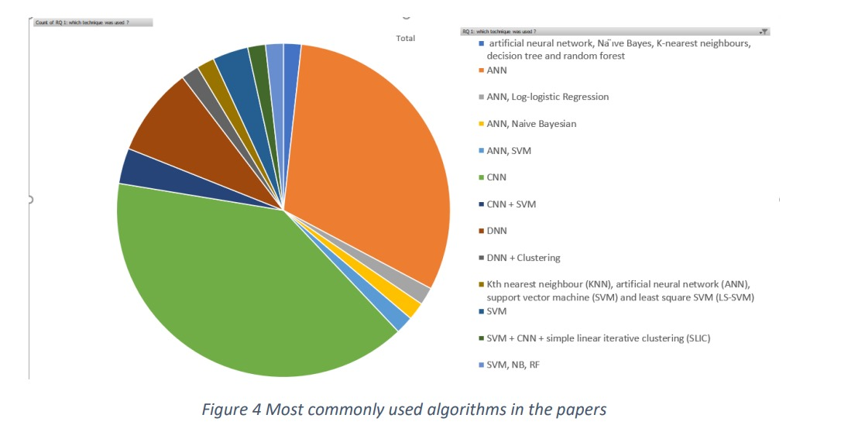
The chart highlights the most commonly used algorithms in breast cancer research. CNNs (Convolutional Neural Networks) dominate, followed by ANN (Artificial Neural Networks), DNN (Deep Neural Networks), and SVM (Support Vector Machines).
CNNs are favored for their ability to process image data effectively. ANN and DNN follow closely due to their flexibility and capacity to handle complex patterns. SVM's use reflects its efficiency in binary classification tasks.
This trend is driven by advancements in AI, the availability of imaging data, and the need for precise cancer classification.

Slide 9
Breast Cancer Detection and Classification Using Hybrid Feature Selection and DenseXNet Approach(2023)
Researchers : Mohammed Alshehri, Majmaah University, Saudi Arabia (Published: Nov 2023)
Aim: Develop a novel framework for detecting and classifying breast cancer using mammography.
Objective: Improve diagnostic accuracy with hybrid feature selection and DenseXtNet architecture.
Methodology:
Preprocessing: Noise reduction (adaptive filtering, histogram equalization).
Feature Extraction: Haralick features, Gabor filters, VGG16 deep features.
Data Augmentation: CycleGANs for dataset variability.
Feature Selection: HRDSO (Hybrid Red Deer + Sparrow Optimization).
Model: DenseXtNet (DenseNet + optimized ResNeXt).
Outcome: Achieved 97.58% accuracy; robust performance in distinguishing benign/malignant tumors.
In the next slide , there are few images for the same giving some idea of the work done.

Slide 10
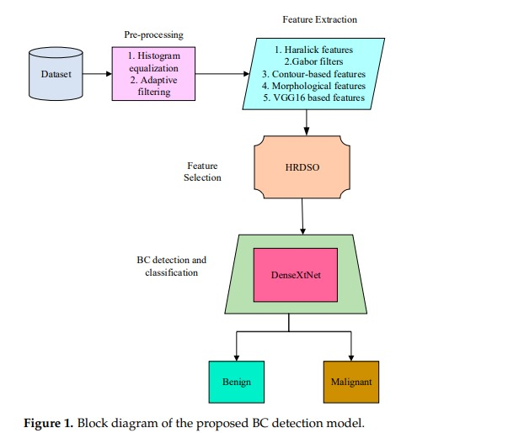

Slide 11
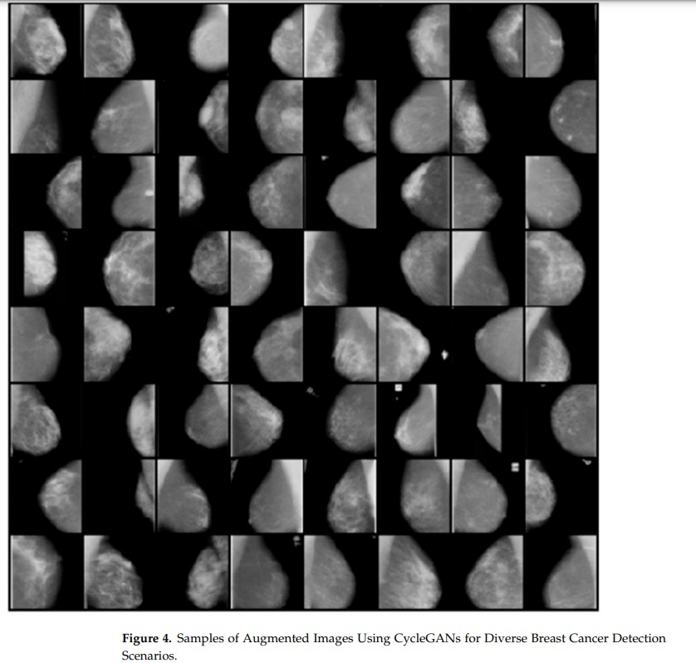

Slide 12
2. Brain Tumor Segmentation Based on an Improved U-Net(2022)
Researchers: Published by BMC Medical Imaging in 2022, led by a team from medical imaging research groups.
Aim: To enhance segmentation performance in MRI scans by improving the U-Net architecture for better detection of tumor boundaries.
Objective: Address limitations of traditional U-Net, such as insufficient feature extraction and poor edge preservation.
Methodology:
Developed an SCU-Net model that incorporates Hybrid Dilated Convolutions (HDC) to increase the receptive field without losing resolution.
Used a dual encoder-decoder setup to enhance feature extraction and refine segmentation boundaries.
Applied advanced concatenation techniques to improve feature-sharing across layers.
Technologies: U-Net, HDC modules, ReLU activation, convolutional layers.
Outcome: Achieved improved precision in delineating tumor edges and segmentation accuracy in noisy MRI datasets.

Slide 13
3. Deep Learning Approaches for Brain Tumor Detection(2021)
Researchers: Conducted by a multidisciplinary team of radiologists and AI experts, published in Australasian Physical & Engineering Sciences in Medicine in 2021.
Aim: To explore and implement U-Net variants for detecting brain tumors with high accuracy and robustness in noisy imaging data.
Objective: Improve the segmentation and classification of brain tumors using deep learning.
Methodology:
Applied U-Net variants for tumor boundary identification, leveraging its encoder-decoder architecture for spatial localization.
Introduced regularization techniques to handle overfitting in smaller datasets.
Conducted experiments using diverse MRI datasets to evaluate the generalizability of the models.
Technologies: Variants of U-Net, CNNs, and optimization techniques.
Outcome: Improved segmentation performance, showcasing deep learning’s capacity for accurate tumor detection in ambiguous medical images.

Slide 14
4. Comprehensive Review on MRI-Based Tumor Segmentation(2021)
Researchers: Published in Multimedia Tools and Applications, 2021 by an interdisciplinary research team focused on computer vision in medicine.
Aim: To review state-of-the-art segmentation techniques for MRI tumor detection and identify gaps in existing methods.
Objective: Highlight machine learning and deep learning advancements, particularly their application in tumor boundary detection.
Methodology:
Analyzed segmentation models like CNNs, U-Nets, and Fully Convolutional Networks (FCNs).
Evaluated challenges such as low contrast, noise, and irregular tumor shapes in MRI scans.
Discussed the strengths and weaknesses of various approaches.
Technologies: CNNs, U-Nets, image preprocessing techniques.
Outcome: Established a roadmap for future work, emphasizing hybrid approaches combining segmentation and classification for robust tumor analysis.

Slide 15
5. An Early Detection and Segmentation of Brain Tumor Using Neural Networks(2022)
Researchers: Authored by a team from medical AI research, published in BMC Medical Informatics and Decision Making in 2022.
Aim: To propose a neural network-based framework for the early detection of brain tumors from MRI scans.
Objective: Overcome challenges such as noise and variability in tumor shapes, enabling early and accurate detection.
Methodology:
Developed a neural network combining edge detection techniques (e.g., Canny edge detection) with segmentation for precise boundary localization.
Integrated preprocessing steps to denoise images and normalize intensity levels for consistent input quality.
Evaluated performance using real-world MRI datasets.
Technologies: Neural networks, edge detection (Canny), image preprocessing.
Outcome: Achieved high precision in early tumor detection, particularly for irregularly shaped tumors.

Slide 16
6. Machine Learning and Deep Learning for Tumor Detection (2020)
Researchers: Published in Artificial Intelligence Review by AI researchers in 2020.
Aim: To provide a comprehensive review of machine learning methods for tumor detection and classification.
Objective: Compare classical ML methods like Random Forests with modern deep learning approaches like CNNs.
Methodology:
Conducted experiments using supervised learning models such as Random Forests and Support Vector Machines (SVM) for binary tumor/non-tumor classification.
Evaluated the impact of CNNs in feature extraction and automatic learning of spatial patterns in imaging data.
Technologies: Random Forests, SVM, CNNs.
Outcome: Highlighted the superiority of CNNs for high-dimensional feature extraction while advocating for hybrid ML techniques.

Slide 17
6. Machine Learning and Deep Learning for Tumor Detection (2020)
Researchers: Published in Artificial Intelligence Review by AI researchers in 2020.
Aim: To provide a comprehensive review of machine learning methods for tumor detection and classification.
Objective: Compare classical ML methods like Random Forests with modern deep learning approaches like CNNs.
Methodology:
Conducted experiments using supervised learning models such as Random Forests and Support Vector Machines (SVM) for binary tumor/non-tumor classification.
Evaluated the impact of CNNs in feature extraction and automatic learning of spatial patterns in imaging data.
Technologies: Random Forests, SVM, CNNs.
Outcome: Highlighted the superiority of CNNs for high-dimensional feature extraction while advocating for hybrid ML techniques.

Slide 18
7. Deep Learning Techniques for Tumor Segmentation(2022)
Researchers: Published in Neural Computing and Applications, 2022 by a team specializing in neural network optimization.
Aim: To improve tumor segmentation accuracy by combining multiple deep learning architectures.
Objective: Address tumor variability in size, shape, and intensity using hybrid architectures.
Methodology:
Proposed a hybrid model combining U-Net and DenseNet for enhanced spatial localization and feature extraction.
Incorporated attention mechanisms to focus on tumor regions while reducing false positives.
Trained and validated on multimodal datasets (e.g., MRI, CT) to ensure generalizability.
Technologies: U-Net, DenseNet, attention layers.
Outcome: Achieved state-of-the-art performance in tumor segmentation across diverse datasets.
Here are the collection of pdfs for reference : Literature_Review_PDFs

Slide 19
Dataset Overview
Classes:
Non-Cancer - 8,060 images
Early Phase - 6,133 images
Middle Phase - 6,210 images
Total Images: Approx. 20,403 images

Slide 20
Data Preprocessing Steps:
Image Resizing :
Resized images to a consistent size (128x128) for uniform processing.
Normalization or Scaling:
Scaled pixel values to a range (e.g., 0 to 1) to standardize image intensity.
Grayscale Conversion:
Converted images to grayscale for consistency and to simplify computations.

Slide 21
Augmentation Techniques applied :
Objective: Improve model generalization and prevent overfitting.
Horizontal Flip: Flips image horizontally, altering spatial orientation.
Random Rotation: Rotates images randomly, enhancing viewpoint variability.
Resize: Rescales image dimensions, adjusts aspect ratios.
Random Crop: Cuts out regions, improves localization robustness.
Perspective Transformation: Tilts images, changing perspective visual effects.
Contrast Normalization: Alters contrast, improves lighting condition generalization.
Brightness Adjustment: Adjusts pixel intensity, varying brightness levels.

Slide 22
Image Preprocessing Techniques
Techniques used in this project:
Gaussian Smoothing
(Reduces noise while preserving edges)
Histogram Equalization
(Improves contrast for better visibility)
Unsharp Masking
(Sharpens edges for clarity)
Wiener Filtering
(Restores blurred images)
Median Filtering (Artifact Removal)
(Removes salt-and-pepper noise)
Morphological Operations(Closing and Opening)
(Removes small artifacts)

Slide 23
Feature Extraction with HOG
HOG captures edge structures and gradients, which are crucial for understanding shapes in tumor regions.
It reduces the complexity of the data while retaining significant features for machine learning models like SVM and RF.

Slide 24
Machine Learning Approach
Support Vector Machine (SVM): A linear kernel was used to classify the HOG features, achieving an accuracy of 74%.
Random Forest (RF): An ensemble method that combines decision trees, resulting in a slightly higher accuracy of 77%.
These models were simple but limited in their ability to capture complex patterns compared to deep learning.

Slide 25
Why Random Forest Outperformed SVM (Linear Kernel)
Aspect | SVM (Linear Kernel) | Random Forest (RF)
Non-Linear Relationships | Assumes linear separability; struggles with complex, non-linear patterns in HOG features. | Captures non-linear relationships effectively through tree-based splits.
Feature Importance | Treats all features equally. | Identifies and leverages the most informative features.
Noise Robustness | Sensitive to noise and outliers; affected by misclassified points. | Averages predictions across trees, reducing the impact of noise.
High-Dimensional Data | Struggles with high-dimensional HOG features; prone to underfitting. | Handles high-dimensional features more effectively through feature subset selection at splits.

Slide 26
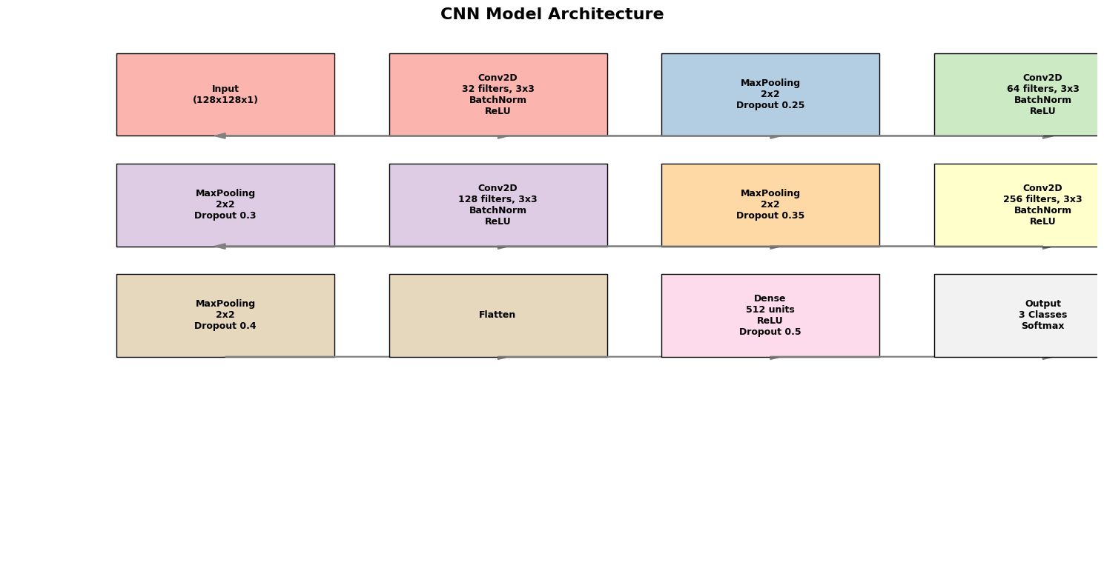
CNN Architecture

Slide 27
MobileNetV2 Architecture
A pre-trained model known for being lightweight and efficient.
Feature Extraction Phase: The base layers, already trained on ImageNet, are used without modification.
Fine-Tuning Phase: All layers are unfrozen, and the model is trained with a reduced learning rate, allowing it to adapt to your specific dataset.
Achieved very less accuracy from what we expected.

Slide 28
Final Result
At the end , we chose CNN as the best model giving 80.6 percent accuracy on the test dataset.
Why Deep Learning is more suitable :
Feature Learning: CNN directly learns features from tumor images without relying on separate feature engineering steps.
Flexibility: Handles large datasets and generalizes better to unseen data.

Slide 29
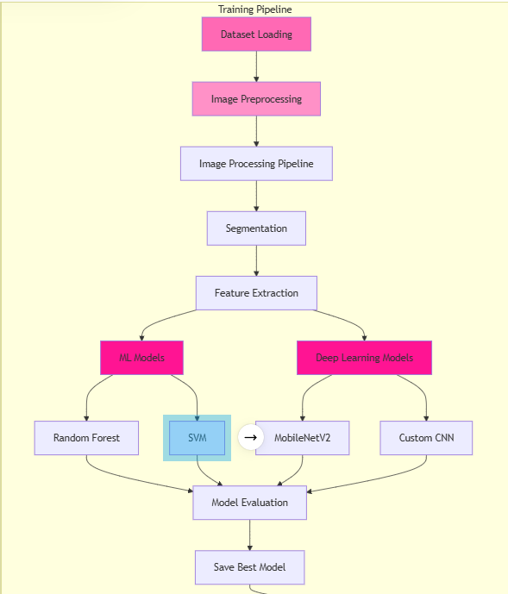
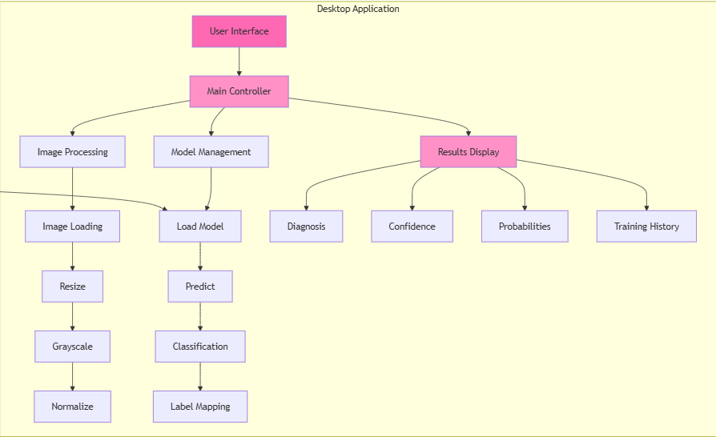
Software Block Diagram

Slide 30
Why CNN Outperformed MobileNetV2 in Breast Cancer Stage Classification :
Domain-Specific Learning: CNNs capture critical medical imaging features like tumor texture and edges, essential for accurate classification.
Training from Scratch: Direct training on the target dataset enables CNNs to learn patterns tailored to medical imaging, unlike MobileNetV2's reliance on pre-trained weights.
High-Resolution Details: CNNs preserve fine details necessary for distinguishing subtle tumor stage differences, which MobileNetV2 may overlook due to its lightweight design.
Flexibility in Architecture: Custom CNNs allow fine-tuning of layers, filter sizes, and activations to match the unique characteristics of breast tumor datasets, leading to better feature representation compared to MobileNetV2’s fixed design.

Slide 31
Comparison Table: Machine Learning Models vs. CNN vs. MobileNetV2
Aspect | Machine Learning Models | Custom CNN | MobileNetV2 (Pre-trained)
Accuracy | Low to moderate, due to reliance on handcrafted features. | High, as it learns domain-specific features directly. | Moderate, limited by transfer learning constraints.
Feature Extraction | Handcrafted features; lacks domain-specific insights. | Automatically learns critical tumor patterns. | Generalized features not tailored to medical images.
Flexibility | Limited by predefined feature sets and models. | Highly customizable for dataset characteristics. | Fixed lightweight architecture; less adaptable.
Resolution Handling | Struggles with high-resolution inputs. | Effectively preserves fine details in images. | Optimized for lower resolution; may miss nuances.
Training Approach | Rule-based and statistical; prone to overfitting. | Trained from scratch for task-specific accuracy. | Relies on pre-trained weights; less effective in adaptation.
Computational Demand | Low; suitable for simpler tasks. | Moderate; higher for complex tasks but effective. | Low; optimized for efficiency over task precision.

Slide 32
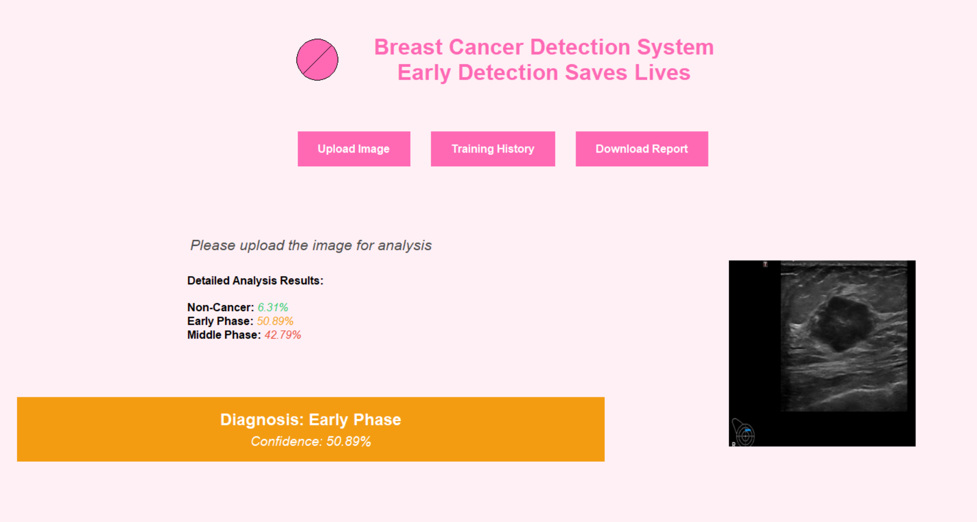
Sample image of stage classification

Slide 33
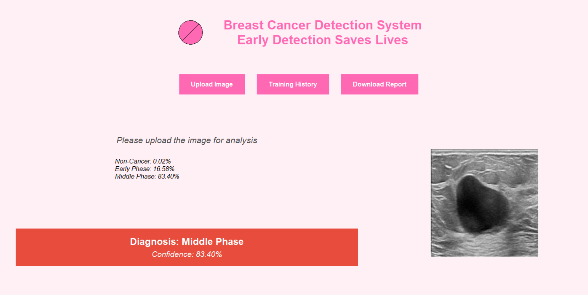

Slide 34
Key Findings
CNNs Outperformed Traditional Models but Underperformed MobileNetV2.
Training from Scratch is Crucial for Task-Specific Accuracy :
able to adapt directly to the dataset, learning patterns specific to breast cancer tumor imaging.
High Resolution is Crucial:
Custom CNNs preserved fine image details, which were essential for detecting subtle differences in tumor stages.
Importance of Customization:
CNNs' flexibility to customize the architecture (number of layers, filter sizes, activations) for specific datasets allowed them to outperform MobileNetV2, which follows a fixed architecture designed for computational efficiency.

Slide 35
Challenges faced :
Data Quality and Availability: Small or imbalanced datasets can result in poor generalization and overfitting.
Computational Demands of CNNs: While CNN's achieved high accuracy, they are computationally intensive.
Transfer Learning Limitations: Although transfer learning from pre-trained models like MobileNetV2 provides computational efficiency, it is not always effective for domain-specific tasks like medical imaging.
Overfitting and Model Generalization

Slide 36
Future Scope
Hybrid Models: Combine CNNs with traditional ML models (e.g., SVM, Random Forest) for improved performance. Use CNNs for feature extraction and traditional ML models for classification.
Real-time Detection: Deploy on edge devices such as smartphones and portable diagnostic tools to enable real-time and remote detection.
Global Access: Adapt the system for deployment in underserved areas, supporting multiple languages and accommodating resource constraints.
Incorporating More Features: Include genetic, hormonal, and lifestyle factors along with imaging data to improve prediction. Add support for multiple imaging modalities like MRI, ultrasound, and mammography.

Slide 37
GUI Application Interface:
Download the full analysis report
Uploading the image for analysis
Detailed analysis of input image
Training and validation accuracy plots
Input Image
Diagnosis phase confidence

Slide 38
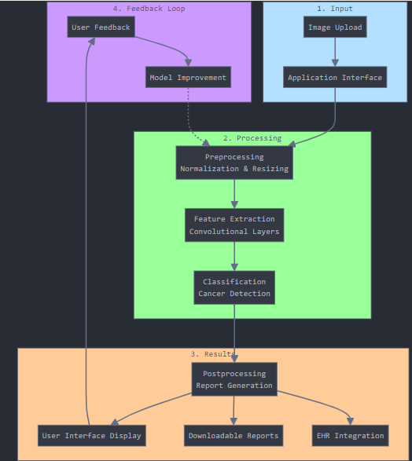
Prediction Flow :

Slide 39

